Slide 1
Synthesis & Structure of Hexafluoridouranates(V)
Lena-Marie Aßmann, Timo Wolf
Supervised by: Jun. Prof. Dr. Suta
28th November 2025
Notes:
Welcome to our presentation about the synthesis and structure of hexafluoridourantes(V)

Slide 2
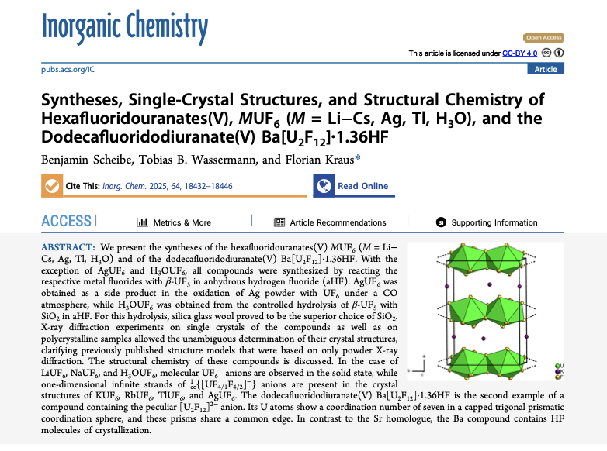
Where can I read about that?
[1] B. Scheibe, T. B. Wassermann, F. Kraus, Inorg. Chem. 2025, 64, 18432–18446.
What are Hexafluoridourantes(V)?
How to synthesize these compounds?
What is the structure of these compounds and
how are the structures connected?
Notes:
These talk is based on a paper by these people which was published this year in the journal Inorganic chemistry. After reading the paper you can answer what hexafluoridourantes(V) are, how these compounds can be synthesized and how the structure of these compounds is and how they are connected to each other. For this they using a lot of rather advanced crystallography

Slide 3



Concepts / Methods
Working with anhydrous HF
Uranium-chemistry
Notes:
At first i will talk a little bit about the methods that are used to synthesize the desired compounds, because they are rather exotic. Lets start with working with anhydrous hydrogen fluoride

Slide 4

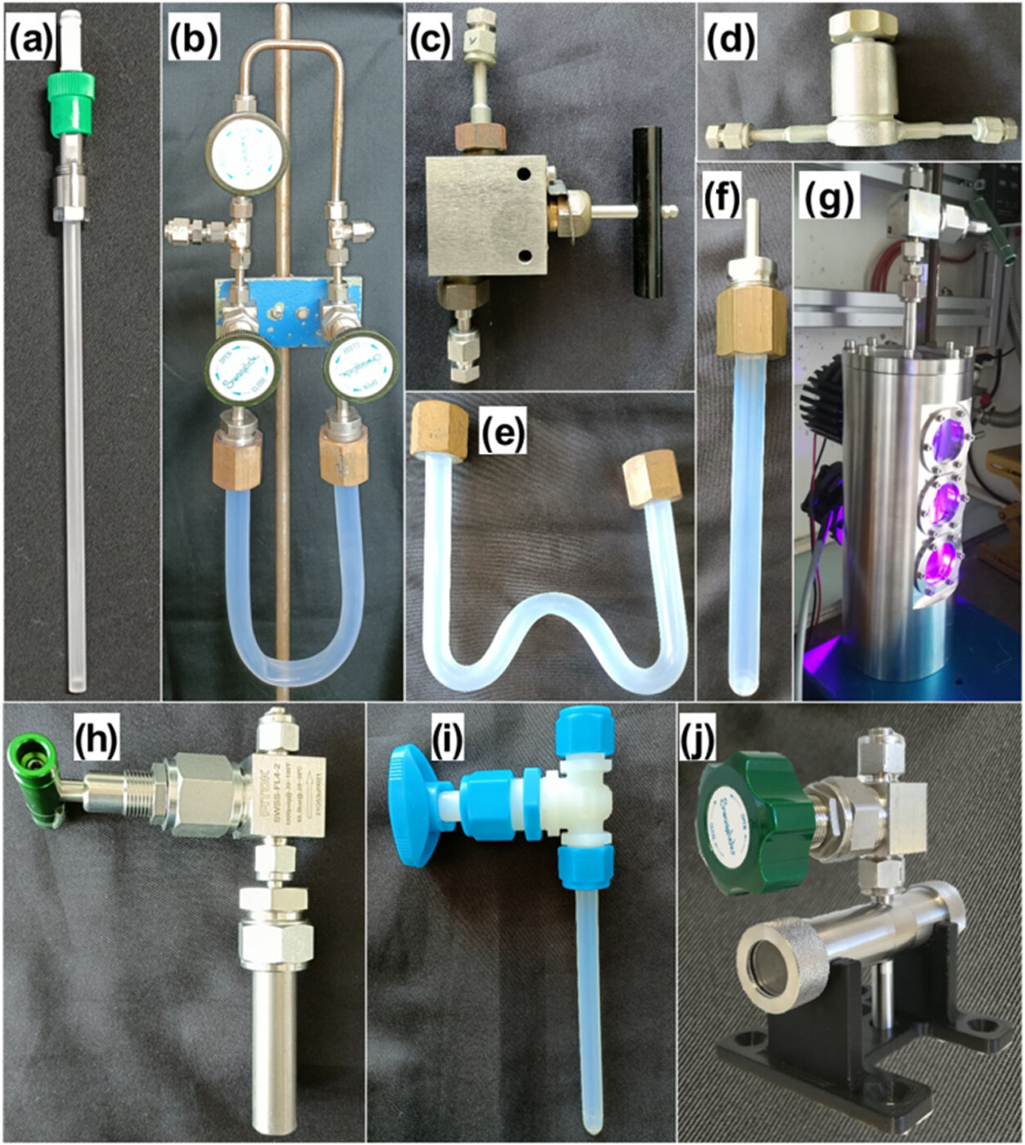
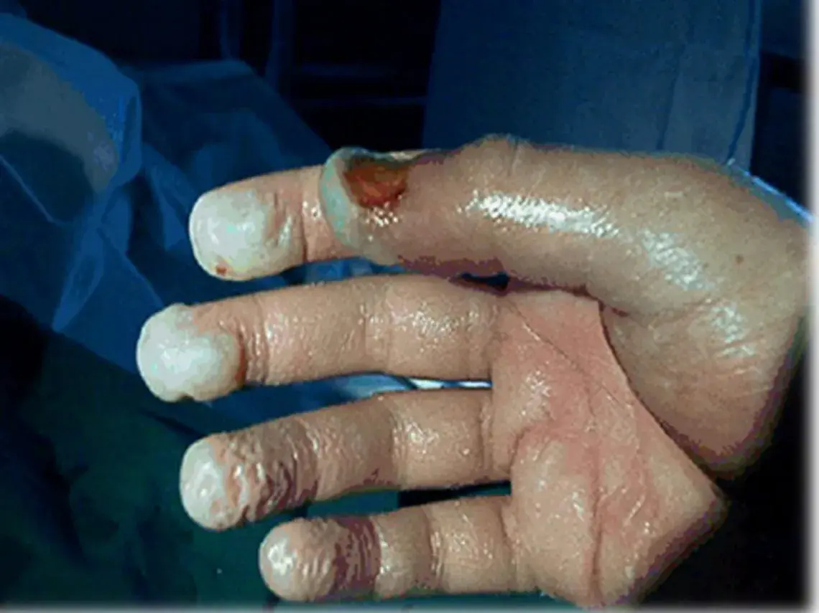
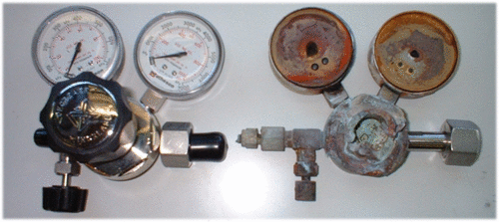
Working with anhydrous HF
HF is very toxic!
Glass vessels can‘t be used!
Passivation & baking out is needed!
Notes:
Hydrogen fluorid and the solution in water called hydrofluoric acid are very toxic and i mean really toxic. The fluorid ions cause the precipation of calcium and magnesium fluoride, which leads to a disturbance of the electrolyte balance in the body. This is often toxic.
Because hydrogen fluorid is one of the only compounds that react with glass you cannot use normal glas ware. Glass can be discribed as silcium dioxide. 4 equivilents of hydrogen fluorid react with silicium dioxide to siliciumtetrafluoride and water. Therefore the schlenk line used is made out of monel, which is a copper-nickel-alloy. The used schlenk tubes are made out of PFA witch is a fluoropolymer.
Before working with this fluoropolymer the reaction vessels were baked out to remove any water. Anhydrous hydrogenfluorid is miscible in any ration with water. The reaction vessels and the schlenk line also need to be passivated before use to make sure nothing gets damadged.

Slide 5

Concepts / Methods
Working with anhydrous HF
Uranium-chemistry
[II]
Notes:
Uranium compounds are also used, although this has become rather uncommon in modern days

Slide 6
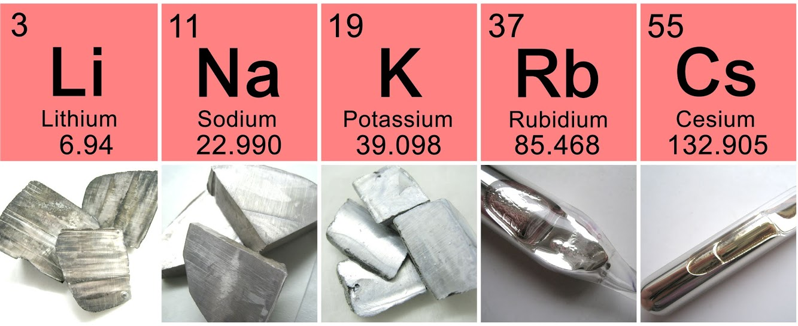
Alkali metals

Slide 7
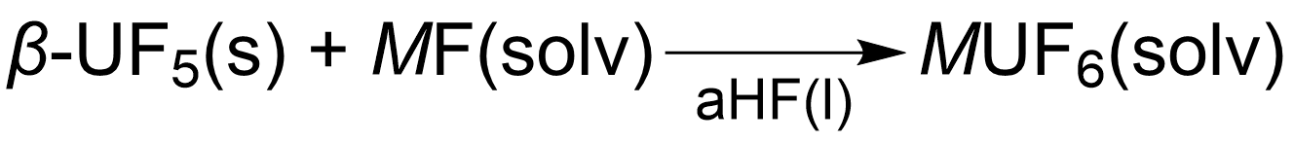
Synthesis of alkali metal Hexafluoridouranates(V) MUF₆
Synthesis of β-UF₅:
Properties: tetragonal symmetry, $I\overline{4}2d$ (No. 122)
Synthesis of MUF₆:
M = Li - Cs

Slide 8
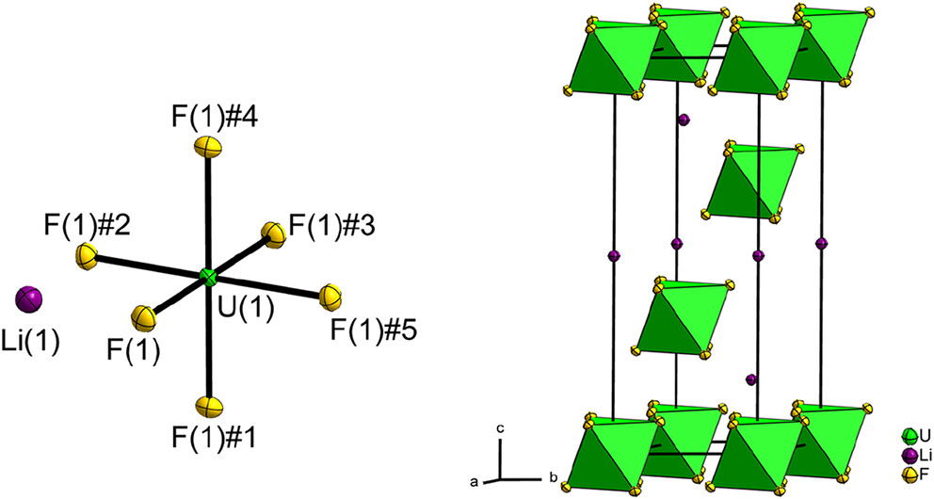

Structural chemistry of LiUF₆
trigonal
$R\overline{3}$ (No. 148)

Slide 9
Structural chemistry of NaUF₆ & CsUF₆
trigonal
$R\overline{3}$ (No. 148)
 | LiUF₆ | NaUF₆ | CsUF₆
a [Å] | 5.1902 | 5.4101 | 8.0284
b [Å] | 14.265 | 15.746 | 8.4388
V [Å³] | 332.78 | 399.12 | 471.05
V/Z [Å³] | 110.93 | 133.04 | 157.02
 | LiUF₆ | NaUF₆ | CsUF₆
d(U-F) [Å] | 2.0624 | 2.0661 | 2.057
d(M-F) [Å] | 2.0061 | 2.2768
d(U-U) [Å] | 5.1902 | 6.1078 | 5.1732

Slide 10
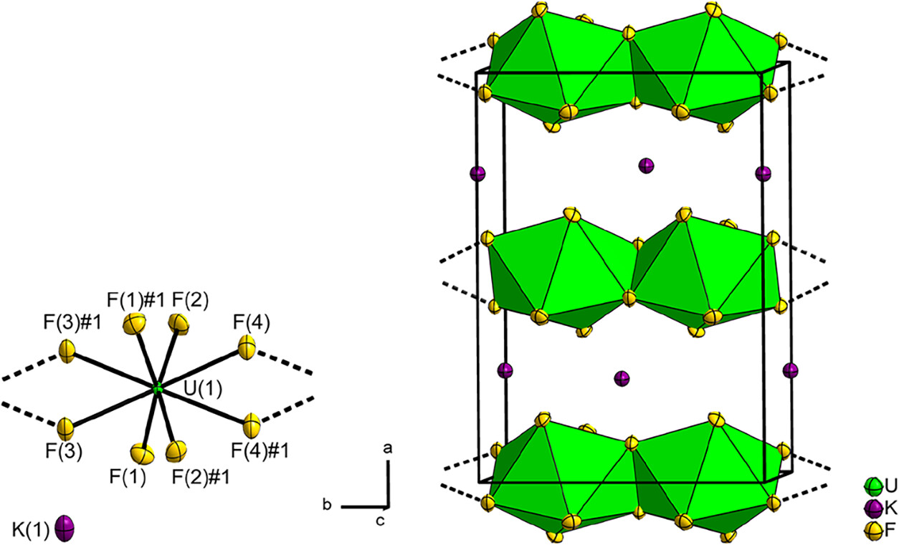

Structural chemistry of KUF₆
monoclinic
$C2/m$ (No. 12)

Slide 11
Structural chemistry of RbUF₆
monoclinic
$C2/m$ (No. 12)
 | KUF₆ | RbUF₆
a [Å] | 11.442 | 11.797
b [Å] | 8.0345 | 8.0167
c [Å] | 5.5655 | 5.7272
β [°] | 90.128 | 90.00
V [Å³] | 511.62 | 541.64
V/Z [Å³] | 127.905 | 135.41
 | KUF₆ | RbUF₆
d(U(1)-F(1)) [Å] | 2.0633 | 2.0600
d(U(1)-F(2)) [Å] | 2.0635 | 2.0573
d(U(1)-F(3)) [Å] | 2.3400 | 2.3286
d(U(1)-F(4)) [Å] | 2.3403 | 2.3286
d(U(1)-U(1)#1) [Å] | 4.0102 | 4.0019
d(U(1)-U(1)#2) [Å] | 4.0243 | 4.0148

Slide 12
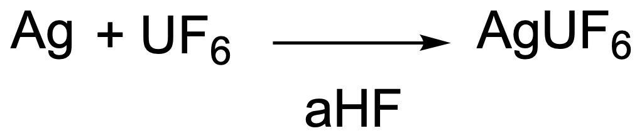
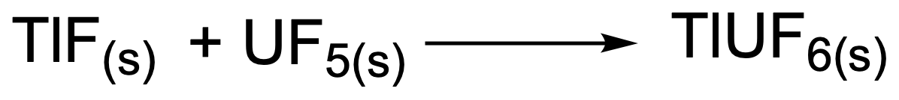
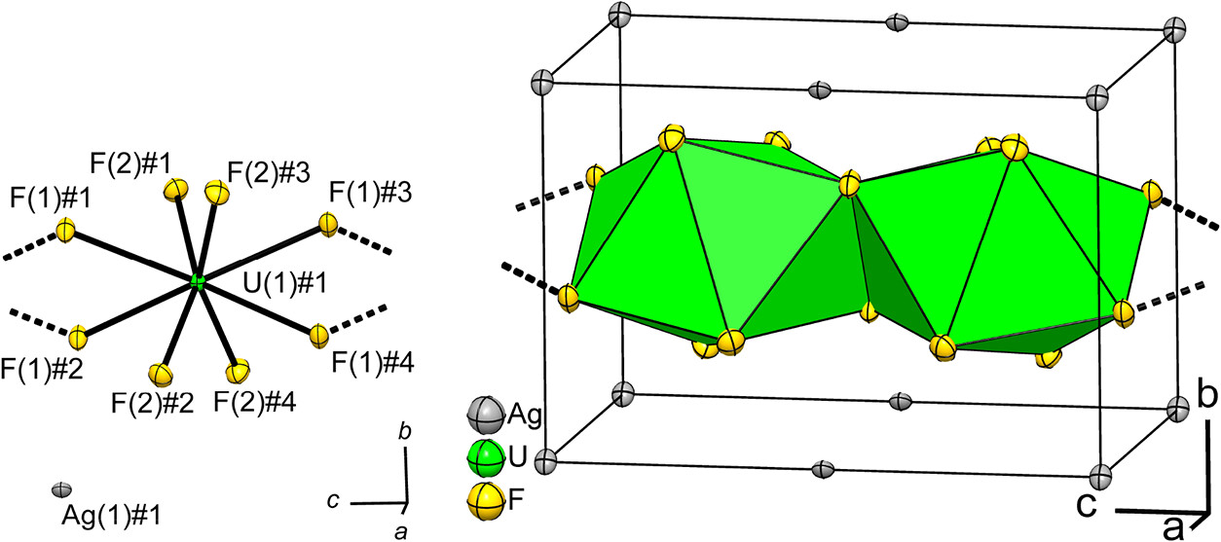
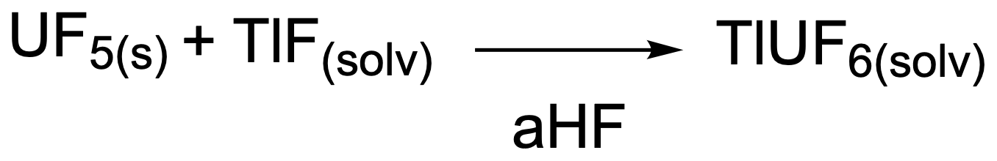

Usage of alkali metal analogus
monoclinic
$C2/m$ (No. 12)
AgUF₆
TlUF₆
Byproduct of a reaction
Solid-state reaction
Preparation in solution
Isotypic to KUF₆!
But: Shorter U-F-bond length, shorter U-U-distances
tetragonal
P4₂/m (No. 84)
Notes:
In addition the group used other metalfluorides like thalliumfluorid which can be described as an alkali metal analog.
There are two ways to synthesis thalliumhexafluoridouranat(5). One is a solid state reaction, the equation is shown here. The other possibility is the preparation of the desired in solution just like all the other compounds. For this case the reaction is shown here.
When it comes to the structural chemistry of TlUF6 it is shown that TlUF6 is isotypic to KUF6, which means it crystallizes in the same space group type. The coordination number of uranium is 8, the coordination polyeder is a distorted trig. Dodecahedron. The coordination number of thallium is 10, the correspondening coordination number is a distorted pentagonal prisma.
In comparision with KUF6 and RbUF6 the Uranium-Fluor-bond length is the shortest. This is due to the larger effectiv ionic radius of the thallium ion. That can be also seen at the shorter Uranium-Uranium distance.
Warum ist Tl+1 stabiler als Tl3+? Inert Pair Effekt bei schweren Hauptgruppenelementen, d-Orbitale sind diffuser und können die zunehmend effektivere kernladung nicht kompensieren, daher werden die s-Orbitale immer inerten, weil sie näher an den Kern gezogen werden. Es ist schwerer die Elektronen aus diesen Orbitalen zu entfernen.
TlUF5 ist isotyp zu KUF6 , also ebenfalls monoklines Kristallsystem, KZ = 8 Uran, Koordinationspolyeder ist verzerrtes trigonales Dodecaeder, Tl+ ist mit zehn Fluoridatomen koordiniert, Koordinationspolyeder ist also

Slide 13
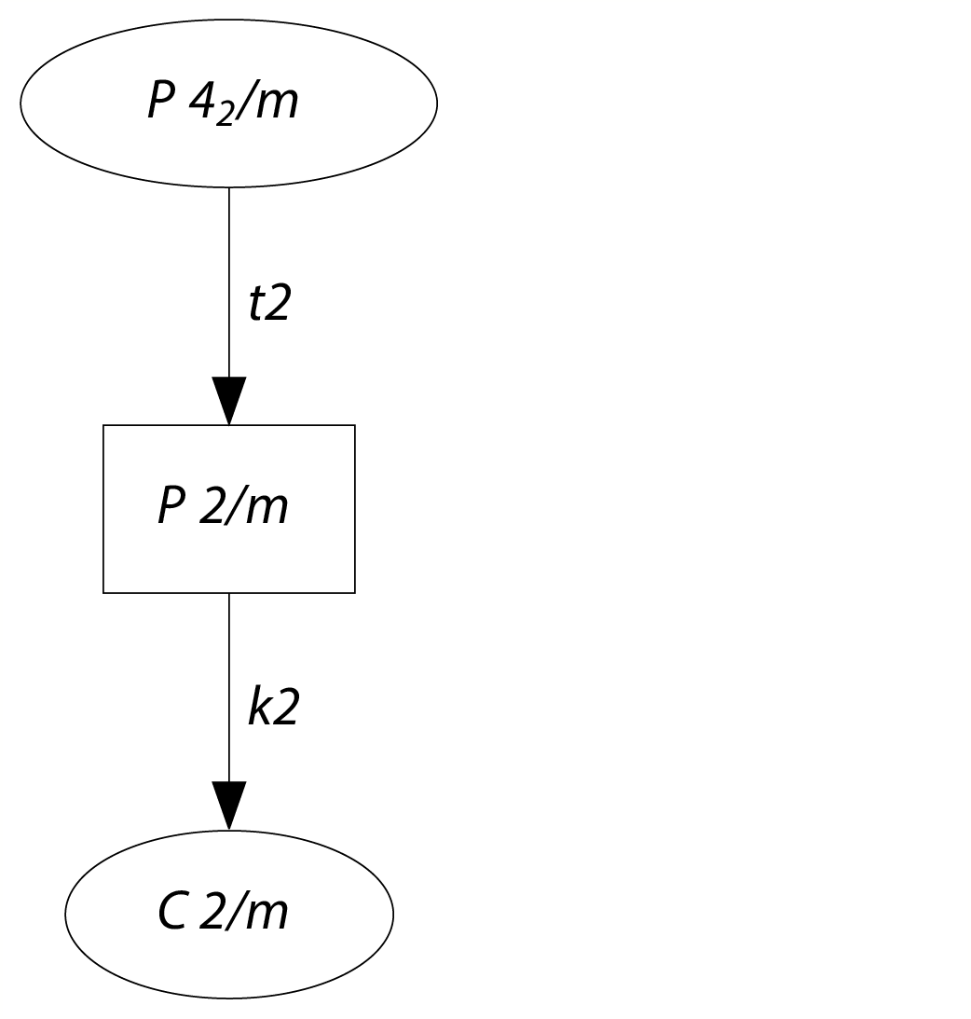
Relationship AgUF₆ & KUF₆

Slide 14
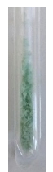
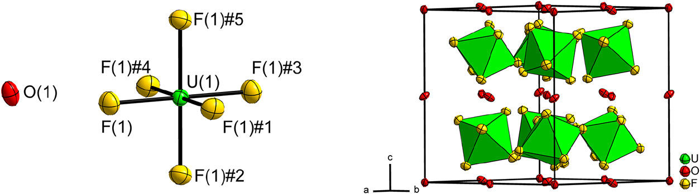
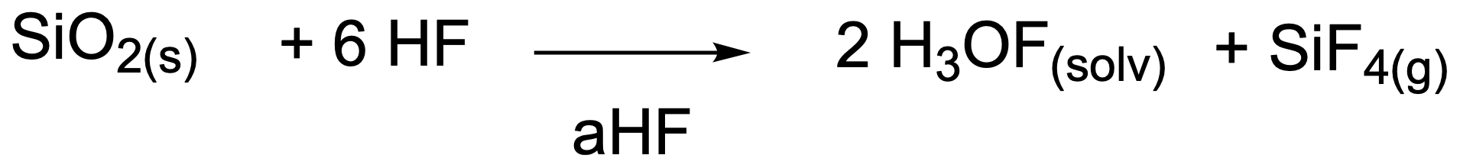
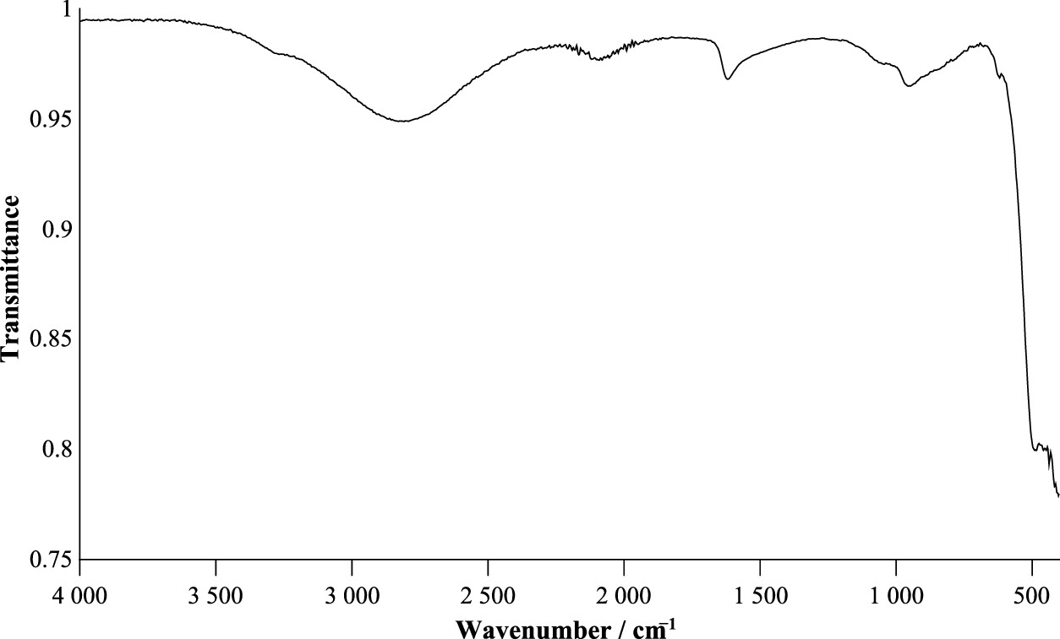
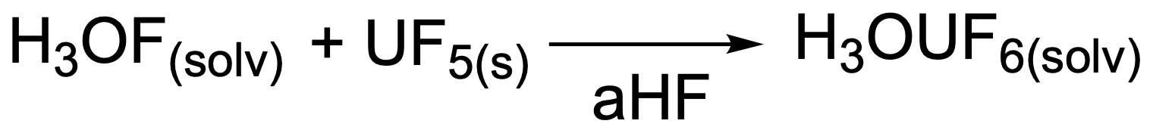

Synthesis of H₃OUF₆
Structural chemistry
How to use water without usage of water?
Cubic
Ia$\overline{3}$ (No. 206)
[1] B. Scheibe, T. B. Wassermann, F. Kraus, Inorg. Chem. 2025, 64, 18432–18446. Supporting Information

Slide 15
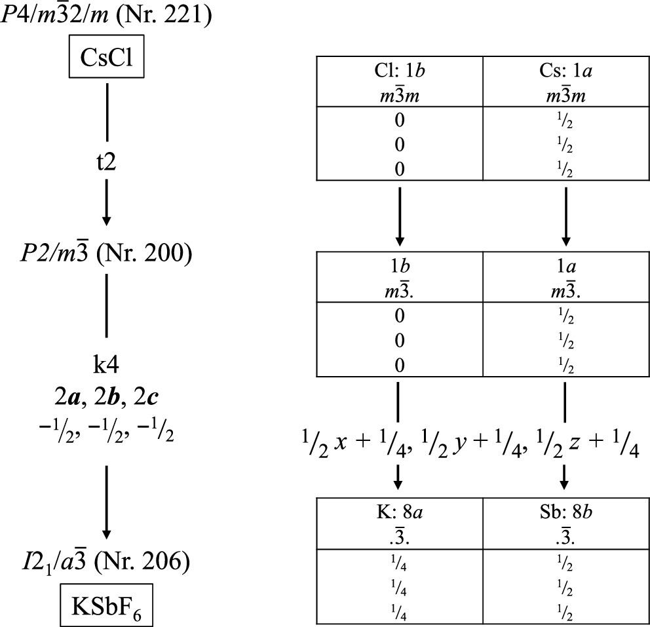
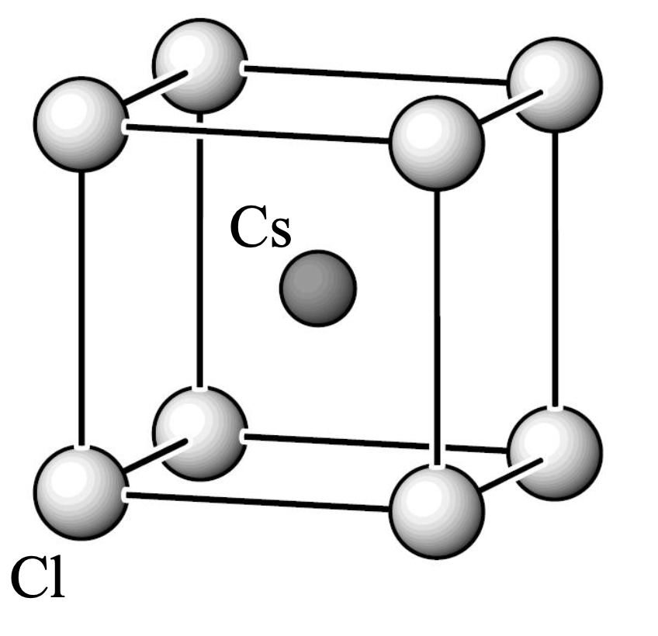
Structural chemistry
[7] U. Müller, Anorganische Strukturchemie, Vieweg & Teubner, 2008.

Slide 16
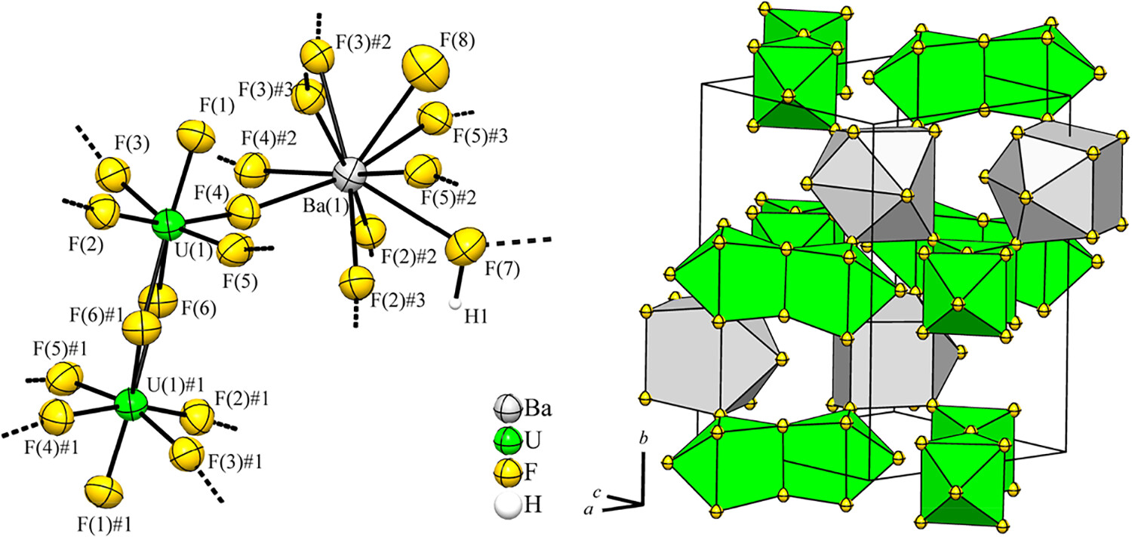
Synthesis of Ba[U₂F₁₂]·1.36 HF
Structural chemistry
Similar to the previous synthesis of Sr[U₂F₁₂]
orthorhombic
Pnma (No. 62)

Slide 17


Thank you for listening. Are there any questions?

Slide 18


What is good & what is bad?
Unusual topic and synthesis methods
A lot of different structures
Nicely written & understandable without expertise
Structure of cubic NaUF₆?
More information on CsUF₆?
What’s about other earth alkali metal U₂F₁₂ compounds?

Slide 19

If we have sparked your interest:
Videos about and with Florian Kraus & his group
The Most Dangerous Chemical Reaction – Fluorine Meets Cesium
by Advanced Tinkering
FluorLab
by Advanced Tinkering
Everything you ever wanted to know about the production and purification of alkali metals
by Advanced Tinkering
Wie GEFÄHRLICH ist Fluor? Das REAKTIVSTE Element der Welt!
by Elias Experiments
Or short videos by Florian Kraus himself! @FluorineIsGreat

Slide 20
Comparison of the structural data
 | LiUF₆ | NaUF₆ | CsUF₆
crystal system | trigonal | trigonal | trigonal
space group | R-3 | R-3 | R-3
Z | 3 | 3 | 3
a [Å] | 5.1902 | 5.4101 | 8.0284
b [Å] | 14.265 | 15.746 | 8.4388
V [Å³] | 332.78 | 399.12 | 471.05
V/Z [Å³] | 110.93 | 133.04 | 157.02
 | LiUF₆ | NaUF₆ | CsUF₆
d(U-F) [Å] | 2.0624 | 2.0661 | 2.057
d(M-F) [Å] | 2.0061 | 2.2768
d(U-U) [Å] | 5.1902 | 6.1078 | 5.1732

Slide 21
Comparison of the structural data
 | KUF₆ | RbUF₆ | TlUF₆
crystal system | monoclinic | monoclinic | monoclinic
space group | C2/m | C2/m | C2/m
Z | 4 | 4 | 4
a [Å] | 11.442 | 11.797 | 11.895
b [Å] | 8.0345 | 8.0167 | 7.9983
c [Å] | 5.5655 | 5.7272 | 5.6787
β [°] | 90.128 | 90.00 | 90.00
V [Å³] | 511.62 | 541.64 | 540.28
V/Z [Å³] | 127.905 | 135.41 | 135.07
 | KUF₆ | RbUF₆ | TlUF₆
d(U(1)-F(1)) [Å] | 2.0633 | 2.0600 | 2.0538
d(U(1)-F(2)) [Å] | 2.0635 | 2.0573 | 2.0611
d(U(1)-F(3)) [Å] | 2.3400 | 2.3286 | 2.3241
d(U(1)-F(4)) [Å] | 2.3403 | 2.3286 | 2.3264
d(U(1)-U(1)#1) [Å] | 4.0102 | 4.0019 | 3.9937
d(U(1)-U(1)#2) [Å] | 4.0243 | 4.0148 | 4.0046
d(M(1)-F(1)) [Å] | 2.6995 | 2.833 | 2.8394
d(M(1)-F(1)) [Å] | 3.0950 | 3.1123 | 3.1410
d(M(1)-F(2)) [Å] | 2.6897 | 2.8308 | 2.8311
d(M(1)-F(2)) [Å] | 3.0902 | 3.1168 | 3.1485
d(M(1)-F(3)) [Å] | 2.6762 | 2.7691 | 2.7962
d(M(1)-F(4)) [Å] | 2.6886 | 2.7694 | 2.8052

Slide 22
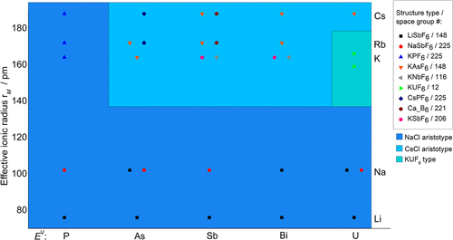
Structural field diagram

